Slide 1
Application for funds TRANSCAN ERA-NET on translational Cancer Research
Aims:
Impact of the health behaviour on clinical outcome in cancer patient (CP)
Optimitation of the quality of life of CP
Prevention of recurrence and second tumour

Slide 2
Application for funds TRANSCAN ERA-NET on translational Cancer Research
Counties in the era-net
Belgium
France
Italy
Netherlands
Spain
Slovenia
…

Slide 3
Optimization of the quality of life of cancer patients
A. …
B. …
C. Testing the influence of co-morbidities on CP clinical outcomes, including survival

Slide 4
RARECAREnet, WP5 contribution to Comorbidity, impact on survival
Positive aspects
Negative aspects
Population-based and comparative studies (different countries)
Variables already available (stage, treatment, path report, etc)
Three or more countries
A new variable to be included (known chronic pathologies)
Sources of data (?)
Experience in this fields
…

Slide 5
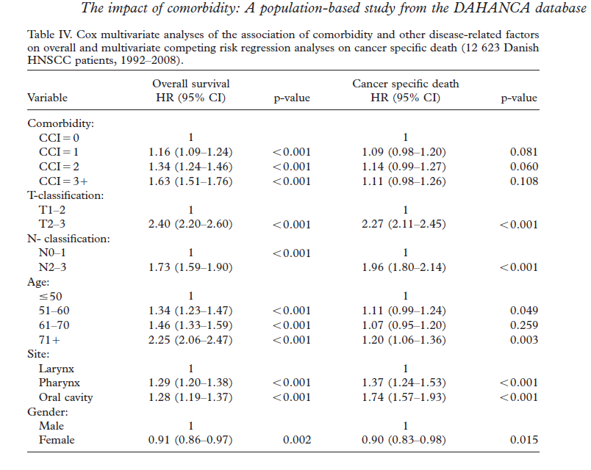

Slide 6
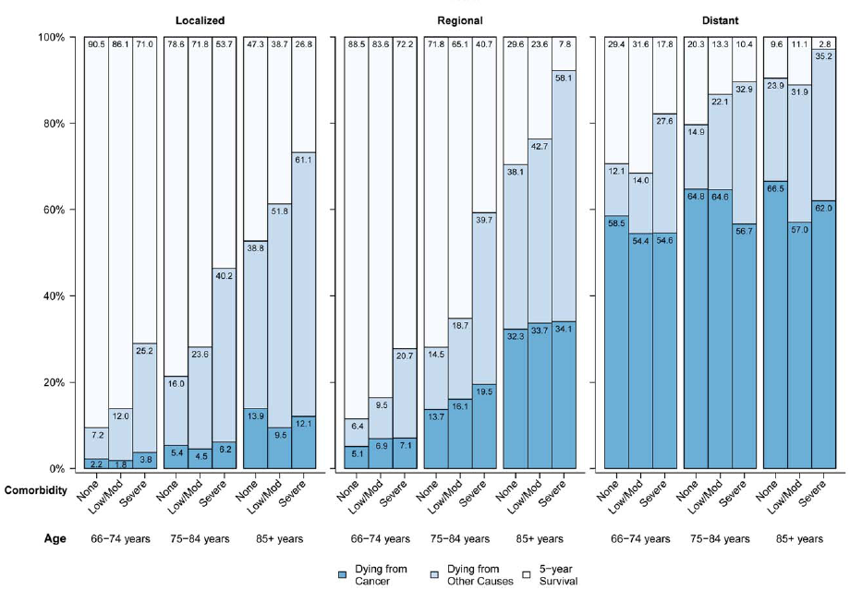

Slide 7
Amount of money and time
1 million euro
Within the end of the year

Slide 8
discussion
Aims
Source of information for
Comorbidity
Death
…
Countries interested/feasibility
First dead line

