Slide 1
BELGIAN CANCER REGISTRY
Meeting 17/01/2014, Utrecht

Slide 2
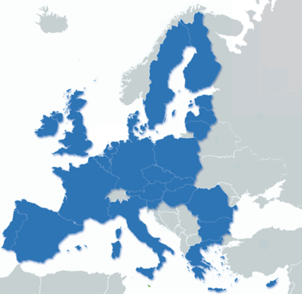
Summary Belgium
National Coverage since 2004, 11 Mio pop
Incidence 2004-2011 available
Flemish Region (northern part) since 1999
2 Councils: General board and Scientific board
Specific legislation dec 2006: Belgian Cancer Registry
Authorisation to use the national number (patient ID)
Quality of the data, linkage, longitudinal follow-up
Linkage autorisation
Clinical data and medical claims/reimbursement data (+drugs)
(SES)
(Geographic - statistical sector)

Slide 3
Data flow
Belgian Cancer Registry Dataflow & sources
Oncology, Radiotherapy depts, Haematology, Paediatry
Pathology labs
Multidisciplinary team meeting data
File specimens + protocol
Health Insurances
+ reimbursement data reimb. drugs (5 years)
Death cert
Cancer Registry
National Registry
Vital status/ death/
Notes:
Medical reimbursement data: diagnostic procedures, surgical procedures, radiotherapy, chemotherapy, immunotherapy, comorbidity medication/drugs, some materials

Slide 4
Cancer registration: data set
Date of incidence
Basis of diagnosis
Topography ICD-O3
Morphology and behaviour ICD-O3
Differentiation grade
cTNM and pTNM
Overview treatment (given and planned)
WHO performance score
Nomenclature: diagnostic procedures, therapy, drugs
Mortality: causes of death
No specific recurrence data, no data on comorbidity

Slide 5
Belgian Cancer Registry
Cancer registration
Clinical db registration projects
Virtual Tumour bank and BBMRI.be
Cyto-histopathology data base
Descriptive epidemiology
Evaluation quality of care
Evaluation screening programs

Slide 6
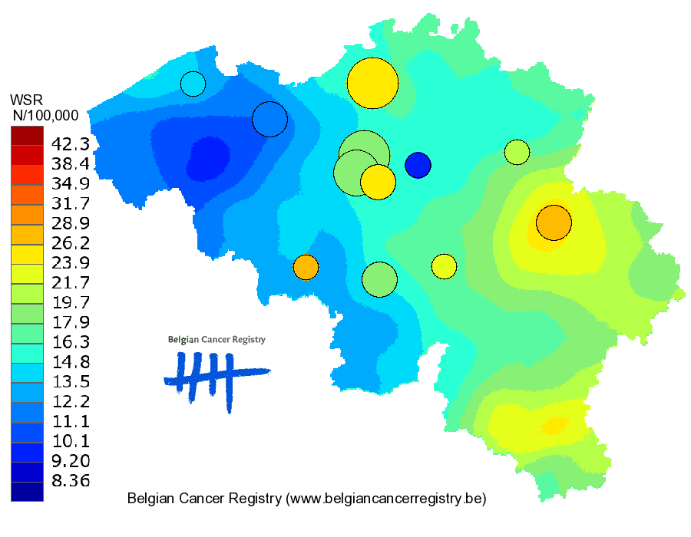
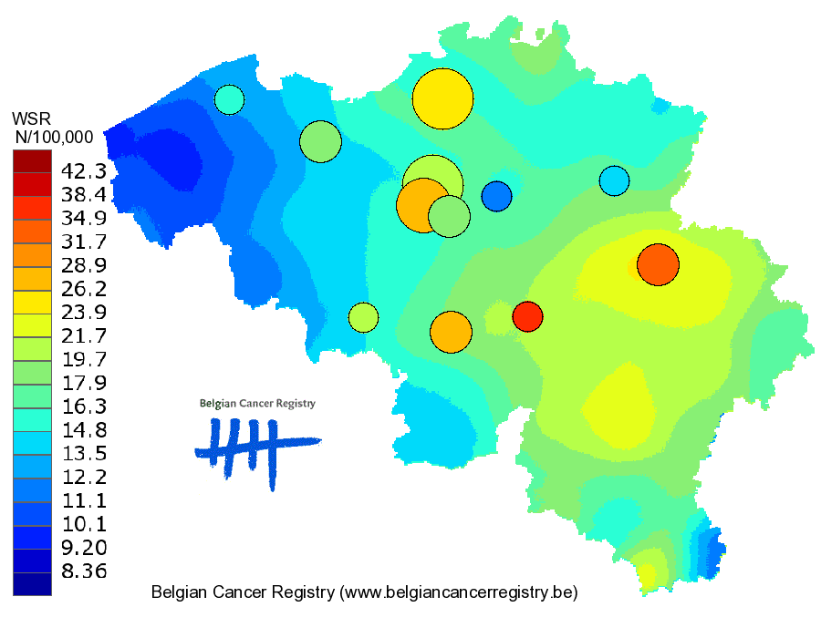
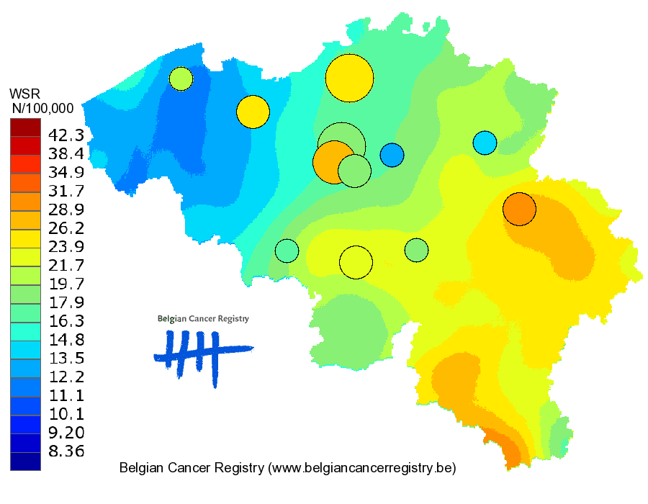
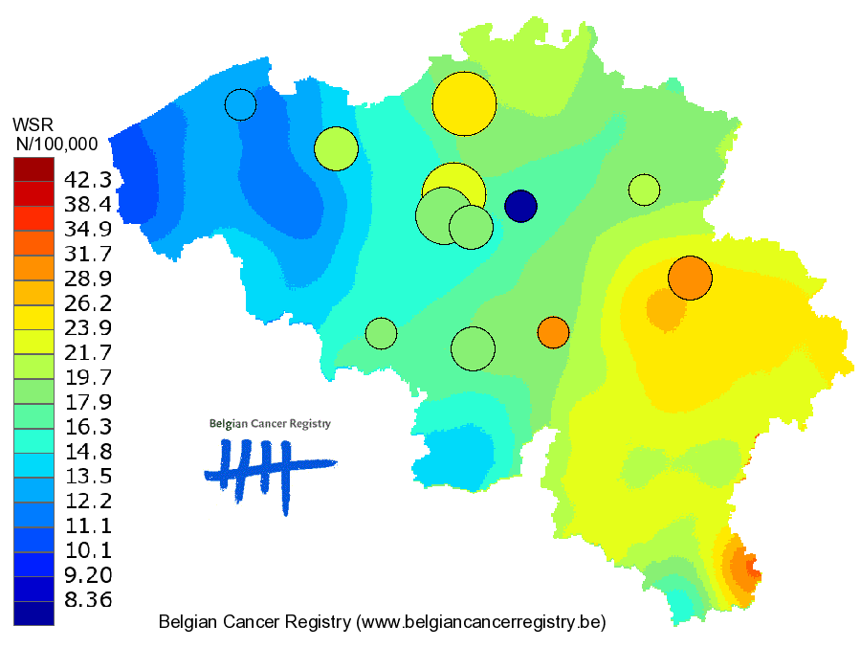
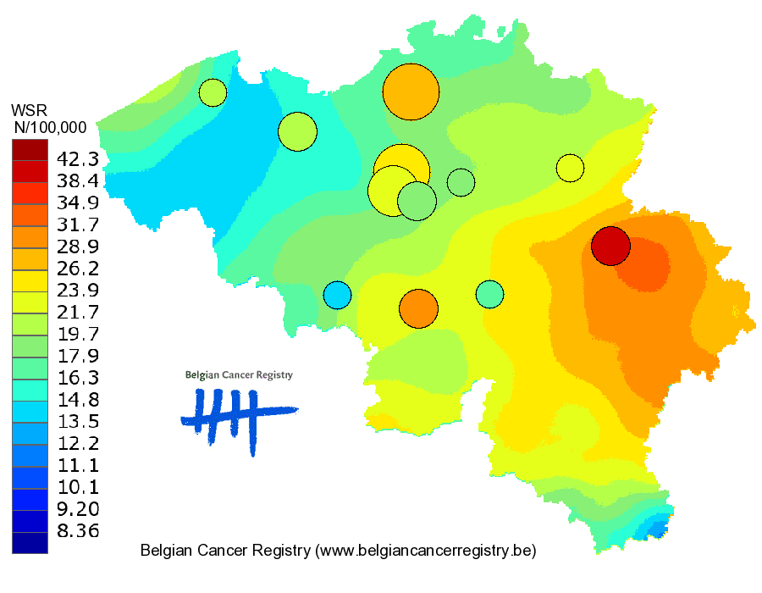
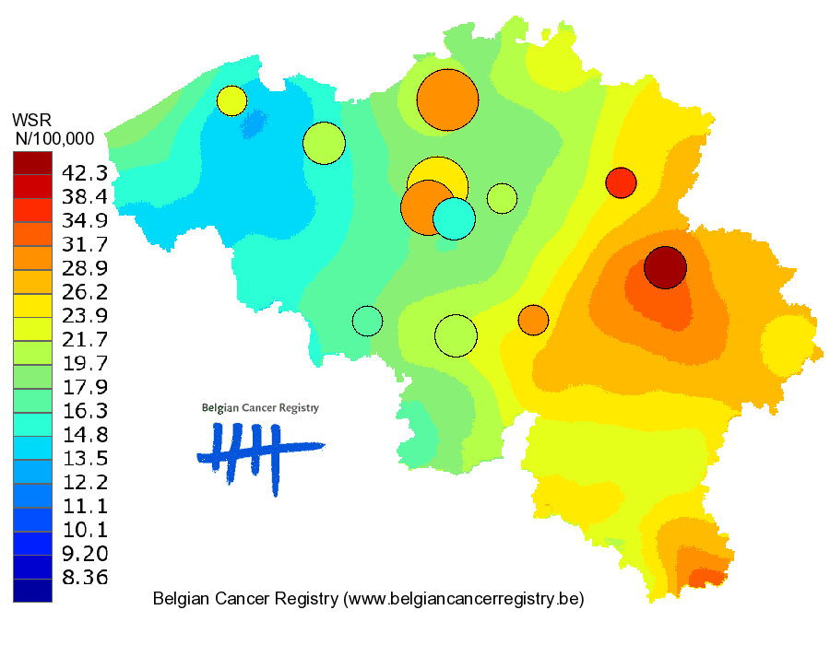
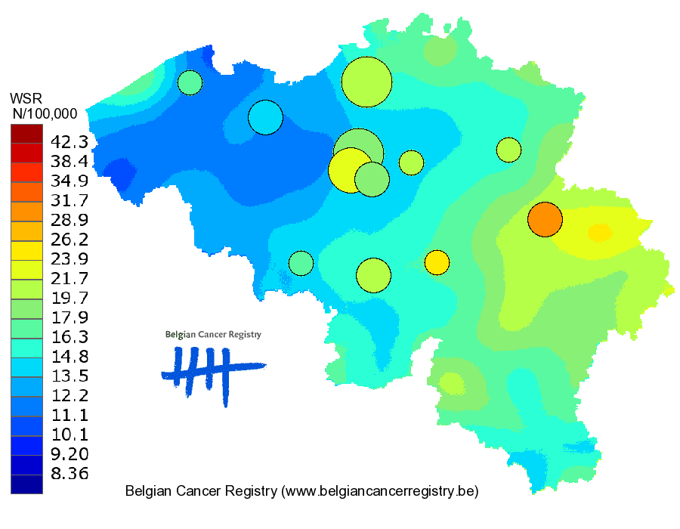
Longkanker Vrouwen
2005
2006
2007
2004
2008
2009
2010

Slide 7
Research: Quality of Care in Oncology
Cancer Registry data linked with administrative data
Use of all reimbursed drugs (chemotherapy, immunotherapy, targeted…)
GCP:
Cancer Registry, Health Insurances, Health Care knowledge Center, College of Oncology
EB Guidelines => measuring quality indicators + individual feedback
Rectum, breast, testis, stomach, esophagus
Near future: lung, head and neck, prostate
Thyroid diseases: Benign-malignant: diagnostic/medical/surgical procedures
Future: Comorbidity?

Slide 8
Health Insurances: Administrative Data
>98% of the Belgian population (11Mio inhab)
7 health insurances
Data => national: Intermutualistic Agency (IMA)
Close collaboration with the Belgian Cancer Registry
Structured information, start 2003
Diagnostic procedures
Surgery, Radiotherapy, Chemotherapy
Pathology
All reimbursed drugs, materials
National code - ATC - date – generic or brand name – no dose

Slide 9
Health Insurances: Interests and future…
HTA
Health Insurances, Health Care Knowledge Center
Example: Lung cancer: “Costs of advanced/metastatic NSCLC in Belgium following 1st-line treatment failure” (crizotinib)

Slide 10
Global limitations
>98% affiliated
Only reimbursed acts and drugs available
Sponsored clinical trials/research
Financial objectives of the administrative db
Misclassification
Timeliness <> prospective registration
Medical act code linked to the patient not to diagnosis
! multiple tumours
Time frames used (cut off)
Surgical acts: not always possible to distinguish between therapeutic and diagnostic interventions

Slide 11
Specific limitations
Head and neck: total number
Radiotherapy: start – end date
Sarcoma: “other therapy”

Slide 12
Developing and measuring a set of process and outcome indicators for breast cancer. Stordeur S, Vrijens F, Devriese S, Beirens K, Van Eycken E, Vlayen J. The Breast 2012; 21 253-260
Effect of hospital volume on processes of care and 5-year survival after breast cancer: A population-based study on 25 000 women. Vrijens F, Stordeur S, Beirens K, Devriese S, Van Eycken E, Vlayen J. The Breast. 2012 Jun; 21(3): 261-6
Regional Variation in Thyroid Cancer Incidence in Belgium Is Associated With Variation in Thyroid Imaging and Thyroid Disease Management Van den Bruel A, Francart J, Dubois C et al. J Clin Endocrin Metab. First published ahead of print August 21, 2013 as doi:10.1210/jc.2013-1705
Patient socioeconomic determinants of the choice of generic versus brand name drugs in the context of a reference price system: evidence from Belgian prescription data.
Farfan-Portet MI, Van de Voorde C, Vrijens F, Vander Stichele R.
Eur J Health Econ. 2012 Jun;13(3):301-313

