Slide 1
Workflow of the Netherlands Cancer Registry
Sabine Siesling
Comprehensive Cancer Centre the Netherlands
Notes:
15 juli nieuwe schermen
instructiesessie

Slide 2
Netherlands
17 million inhabitants
>100,000 new cancer cases per year
97 public hospitals in total
8 university hospitals
1 specialized cancer hospital
28 Educational hospitals
8 regions (former Cancer Centre regions> networks)

Slide 3
Netherlands Cancer Registry
95 hospitals in the Netherlands

Slide 4
Netherlands Cancer Registry

Slide 5
Notification
PALGA> pathology report
first registration
Data on patient, tumour, treatment, co-morbidity
Vital status > linkage with the national municipality registry
< 3 weeks
< 9-12 months
Ones a year

Slide 6
Items gathered directly from the patient files
Patients data
Diagnostics (some tumours)
Tumour data
ICDO
Morphology
# lymph nodes, # positive lymph nodes
Stage in (c and p) TNM (if applicable)
Treatment data
For some tumours in detail

Slide 7
Specialities
For some tumour sites (breast cancer) we gather recurrence of disease within 5 years after diagnosis
In retrospect
From patient files (not only pathologically confirmed recurrences)
With treatment data

Slide 8
Flow annotation
Items &
Possible remarks
Annotation question
Task list selection
Agreed indicatorset
Tasklist specialist
remark
Tasklist Registrar
Change the record
Agreed indicatorset
discussion
(partly )no changes
Notes:
Eerst pilot
Voor valideren gegevens

Slide 9
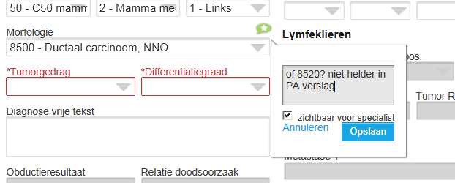
Annotation
Remark is possible per item
- internal (for other registrar)
- External (for clinician)

Slide 10
Change of practice
change the work of the registrars in future in several ways:
more dialogue with clinicians
more monitoring function
more insight in the use of the data
More up-to-date work (deadline)
which all can all improve the data.

Slide 11
Questions?

