Slide 1
Work Package 5
The data collection tool
Utrecht 17th January 2014
The use of the data collection tool
Jan Maarten van der Zwan

Slide 2
ACCESS data collection tool
Why ACCESS?
Positive: - Different options to include data
- Availability of a uniform front screen
- Low costs
- Easy way to upload data
Negative: - No option for real-time data check
- Does only work with correlating version
- No warning options included
Notes:
I expect WP 1 to present the general aim of the project

Slide 3
Data inclusion
Data can be included in three ways:
Automatic Upload of data
Manual inclusion of data
A combination of both
Helpdesk: j.vanderzwan@iknl.nl
Notes:
I expect WP 1 to present the general aim of the project

Slide 4
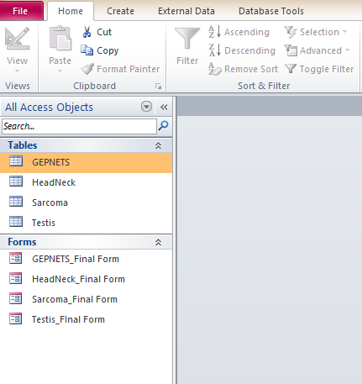
Manual inclusion
Open the Access file
Left-click on the “Forms Tab” on the left of your screen and select the correct category
Double clicking opens the form
Notes:
I expect WP 1 to present the general aim of the project

Slide 5
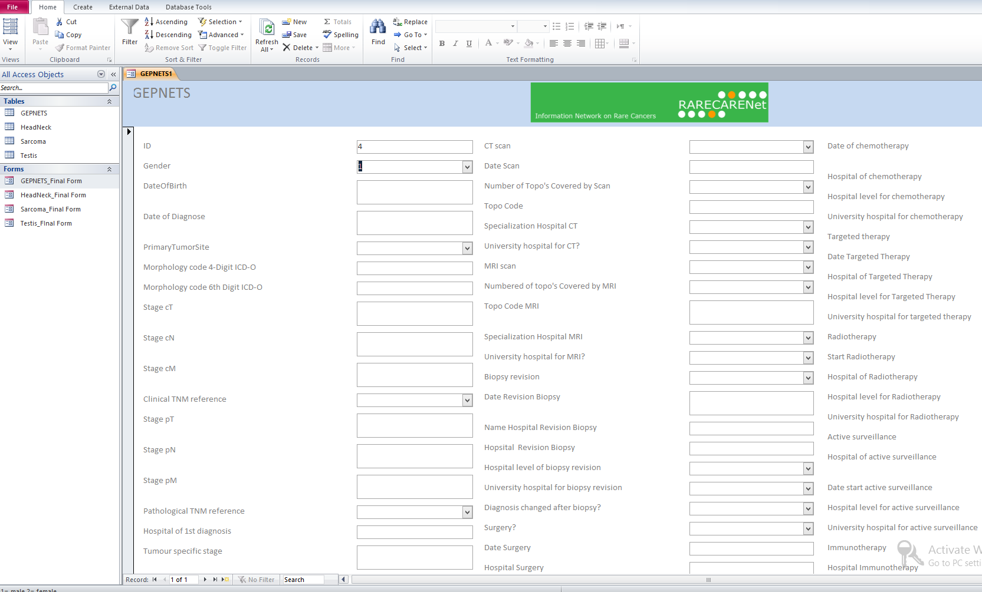
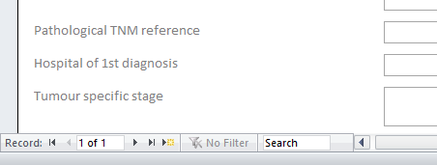
Manual inclusion
CHECK if you fill in a new “Record”,
- click on to go to the last record
- click on to create a new, empty, record
!
Notes:
I expect WP 1 to present the general aim of the project

Slide 6
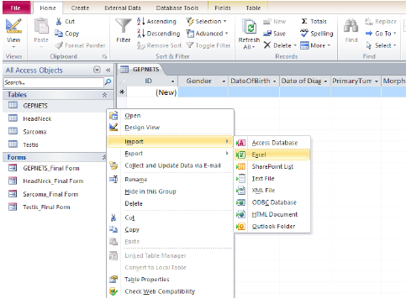
Automated inclusion
1. Open the Access file
2. Right-click with the cursor on the corresponding table
3. Go to “Import”
4. Select the type of data
5. Browse to the file location
6. Select the right table to import the data
Follow the steps in the import wizard and make sure to use the headings of the columns
Notes:
I expect WP 1 to present the general aim of the project

Slide 7
Combined data inclusion
First follow the automated procedure
Second you can manually check following the manual procedure
The other way around is not possible.
Notes:
I expect WP 1 to present the general aim of the project

Slide 8
Questions and suggestions

